Slide 1
PnP Community Call – December 2014
aka.ms/OfficeDevPnP
aka.ms/OfficeDevPnPYammer
aka.ms/OfficeDevPnPGuidance
PnP Core Team

Slide 2

Agenda
Demos, demos, demos
Monthly highlights
Contributions and other topics
Roadmap and next steps

Slide 3
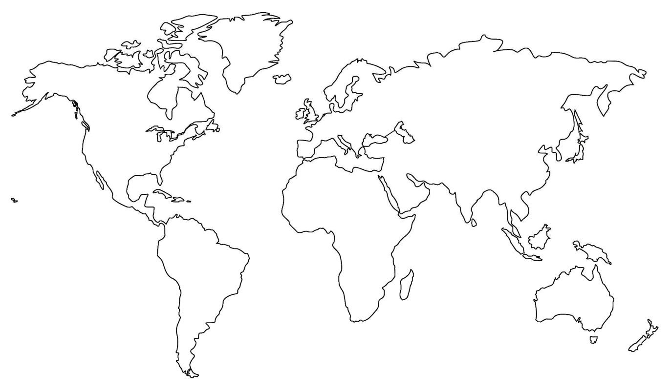

Where are you located?
Stamp Tool
Notes:
Length: 2 minutes for this slide
This slide is a quick demo/practice of the “Stamp” tool and how to use it during course interactions.
Have students Check where they live.
If it’s a small class, have students type their name where they live.
Reach out to the farthest away student

Slide 4


Developer
Patterns & Practices
aka.ms/OfficeDevPnP
aka.ms/OfficeDevPnPYammer

Slide 5
Statistics– Key numbers (previous month)
Forked 226 times (190, 135)
280 merged pull requests (236, 189)
67 closed issues (58, 43)
More than 2566 (3050, 2160) unique visitors during last 2 weeks – holiday season
Nuget package 4030 downloads (3800)
Yammer group has 1525 members (1419, 757)
aka.ms/OfficeDevPnPYammer
Facebook page has 121 likes (some to got still for Office AMS numbers)
https://www.facebook.com/OfficeDevPnP

Slide 6

Thank you for your assistance!
Andrew Connell - @andrewconnell
Erwin Van Hunen (Knowit AB) @erwinvanhunen
Marc Grabow
Mark Wilson @PlanetWilson
Matt Mazzola (Microsoft) - @mdmb54
Nanddeep Nachan (Tieto)
Radi Atanassov (OneBit Software) - @RadiAtanassov
Ricky Kirkham (Microsoft)
Stijn Neirinckx
Vardhaman Deshpande (Content and Code) @vrdmn
Core team – Frank Marasco, Bert Jansen, Vesa Juvonen, Brian Michely, Suman Chakrabarti, Steve Walker

Slide 7
New and updated contributions
Core.OnPrem.S2S.WindowsCertStore (Ricky Kirkham, Microsoft)
Core.DisplayCalendarEvents (Matt Mazzola, Microsoft)
Core.Settings.LocaleAndLanguage (Vesa Juvonen, Microsoft)
Core.Settings.Audit (Vesa Juvonen, Microsoft)
Debug.Tracing (Stijn Neirinckx)
OfficeGraph.Demo.App (Vardhaman Deshpande, Content and Code)
Core.ConnectedSigRAngularJSAppParts (Brian Michely, Microsoft)
OD4B.Configuration.Async (Vesa Juvonen, Microsoft)
Governance.SiteUsageReport (Radi Atanassov, OneBit Software)
Updates
PnP Core (Erwin, Suman, Bert)
PowerShell.Commands (Erwin Van Hunen, Knowit AB)
+ new article section, more on that later

Slide 8
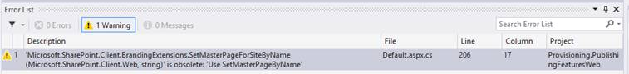
Updates to PnP Core and miscellaneous
Lots of refactoring, updates and improvements done and more to be introduced later
No breaking changes with any updates like in the past, just guidance in VS to drive to right direction
Old methods do work as well, but we indicate changes with obsolete messages
Improvements in unit tests ➔ 133 unit tests available!

Slide 9

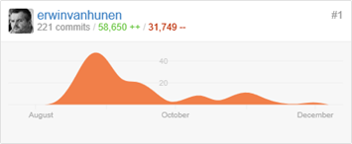
Welcome Erwin to core team
MCM & MVP
Knowit
Software architect
Core team right now
Bert Jansen, Brian Michely, Erwin van Hunen, Frank Marasco, Steve Walker, Suman Chakrabarti, Vesa Juvonen
Notice that core team does that outside of business hours
We have actual customer facing work in day time

Slide 10
Monthly schedule
New schedule starting from January 2015
Master merge first Friday of the month
Monthly call on 2nd Tuesday on each month

Slide 11
New guidance repository
Community contributions in format of generic articles
Code documentation should concentrate on the what the code does
Reasoning and background information should be in own article
We are gradually moving to model where MSDN articles will be updated based on PRs in GitHub
Solution packs will be added to MSDN around end of Jan timeframe
aka.ms/OfficeDevPnPGuidance
Still work in progress with contribution details
Follows similar model as Azure
Early guidance
How to handle OneDrive for Business customization (Vesa Juvonen)
How to configure SharePoint Provider-Hosted Apps for distribution (Andrew Connell)
How to configure Office 365 API Projects for distribution (Andrew Connell)

Slide 12
PnP Core Component moving to v1.0
We target to release v1.0 of the Core component during March master merge
Expected changes
Removal of deprecated methods
Removal of non Office365/SharePoint extensions
Approach towards for v1.0 release
Keep it simple, keep it small
Use class model for complex methods
Use only when truly adds value, no 5 line methods
Unit testing improvements

Slide 13

Roadmap – Something in the todo list
Starter kits
Provisioning
Remote timer jobs
Improvements to core component
Unit testing, logging, other stuff
Guidance to new repository
Application Life Cycle for app model
Design patterns for App model based implementation
Transformation guidance for existing customizations
App model impact for enterprise architecture
Content migration for app model implementation
Continuous integration
We have few initiates to get this moving, while Core team has been too busy with customer facing work...

Slide 14

Demos, demos, demos!
Brian – Connected web parts
SignalR and Angular
Erwin – Core component
Model, changes and unit tests
Vesa - OD4B customizations
Async with WebJobs and storage queues
Bert – Debug.Tracing
Application Life Cycle for app model

Slide 15
Feedback…
Please keep the feedback coming in Yammer… we need your input for the prioritization.
Notes:
Priority on planned topics
More code samples
Add core component capabilities
Reusable presentation material
Documentation on patterns and practices for app model (ALM ec.)
More complex solutions
More Office Client apps
More JavaScript app
Length: 30 second for this slide
Instructor notes
The following slides will walk you though the Lync tools that we will use in this class.
You will use all of these tools later in the class
Stress that your students will be able to run much more engaging meetings if they use these tools in their own Lync Meetings.
Course Development Notes:

Slide 16
Transform your code Providing App Model Patterns for common Full Trust Code scenarios
100+ Visual Studio projects Common scenarios
Branding
Site provisioning
Remote event receivers
Large file support
Taxonomy driven navigation
And much more…
Contribute
This is open source project and open for contirbutions
Developer
Patterns & Practices
aka.ms/OfficeDevPnP

Slide 17

Questions?

Slide 18


© 2014 Microsoft Corporation. All rights reserved. Microsoft, Windows, and other product names are or may be registered trademarks and/or trademarks in the U.S. and/or other countries.
The information herein is for informational purposes only and represents the current view of Microsoft Corporation as of the date of this presentation. Because Microsoft must respond to changing market conditions, it should not be interpreted to be a commitment on the part of Microsoft, and Microsoft cannot guarantee the accuracy of any information provided after the date of this presentation. MICROSOFT MAKES NO WARRANTIES, EXPRESS, IMPLIED OR STATUTORY, AS TO THE INFORMATION IN THIS PRESENTATION.

